Slide 1

MRSP Project Group 8
Group Members:
Farzeel Aftab
Tatiana Merkulova
Aftab Arshad Muhammad Jawad Asghar

Slide 2
Task 1
Audio Data
24-bit, 44100 kHz sound files
Dataset
5 original audio files
15 derivative audio files across 3 acoustic environments: Opera Hall, Reverberation Hall, Small Office
Software Used
Free Sound
Audacity

Slide 3
Task 2
Objective
Analyze and compare perceived quality of audio files after applying two compression methods: Uniform Quantization and AAC Encoding.
Compression Methods:
Uniform Quantization
Divides continuous range of amplitudes into finite levels.
Reduces bit depth, leading to compression.
AAC Encoding
Advanced Audio Coding with better sound quality than MP3 at similar bit rates.
Utilizes perceptual noise shaping and predictive coding.

Slide 4
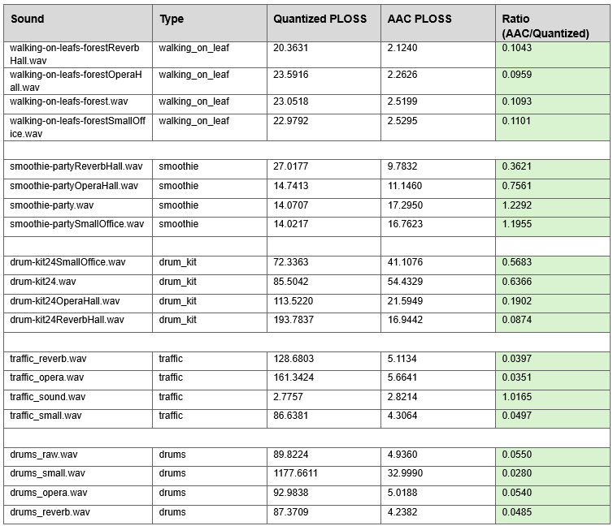
Perceived Quality Loss - Results Overview
Measured for both Quantization and AAC Encoding.

Slide 5
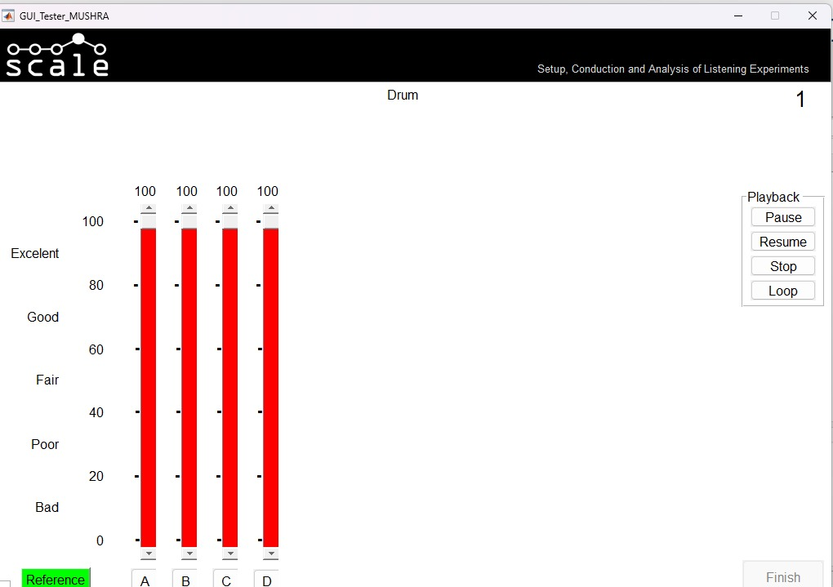
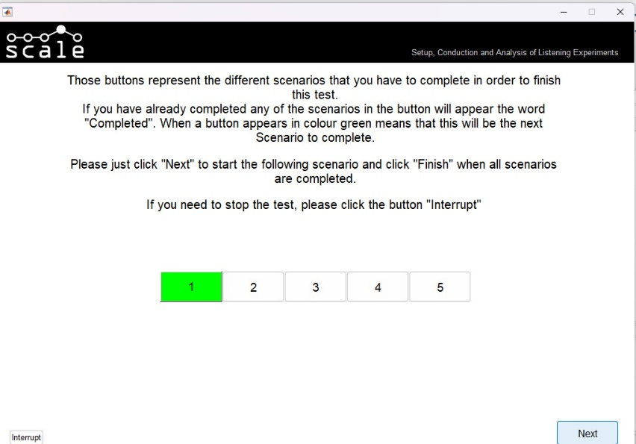
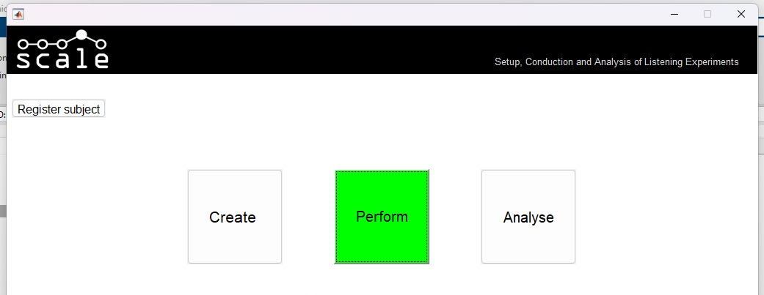
MUSHRA: Subjective Measures

Slide 6
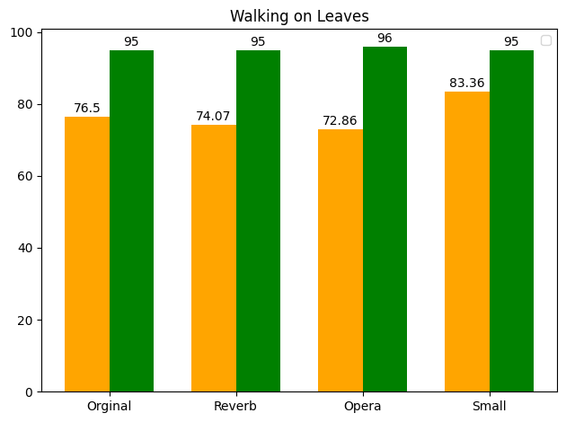
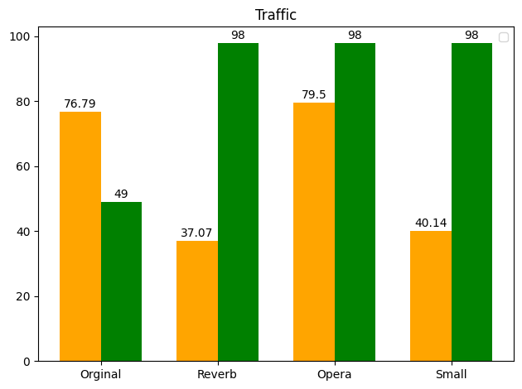
Comparison Graphs

Slide 7
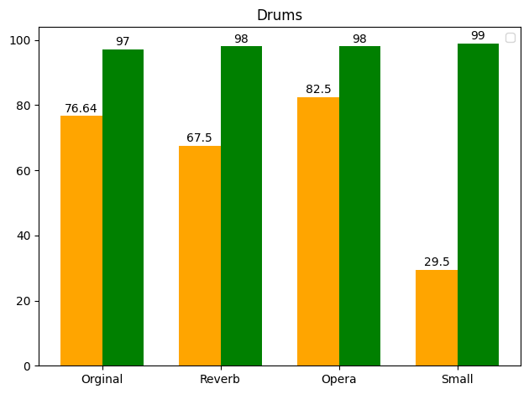
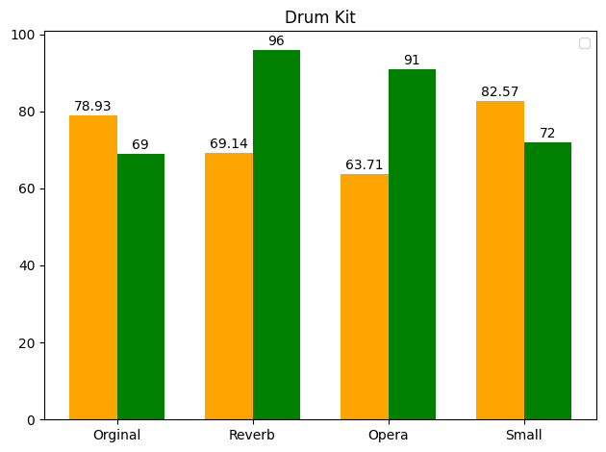
Comparison Graphs

Slide 8
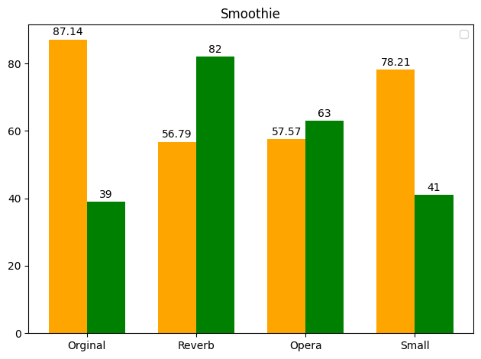
Comparison Graphs

